Slide 1
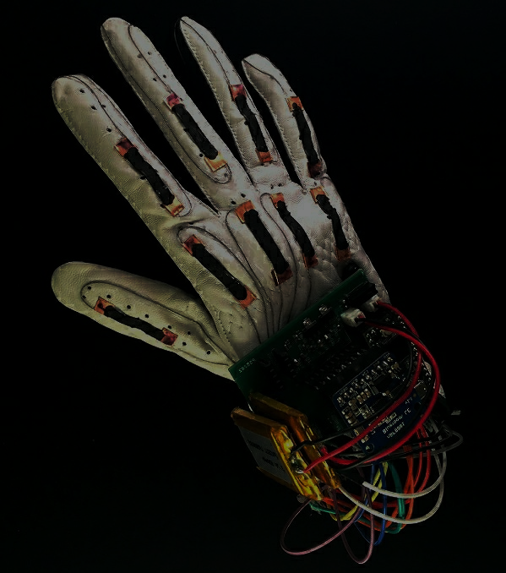
DEPARTMENT OF ELECTRONICS AND COMMUNICATION ENGINEERING THE GESTURE TRANSLATOR
Goutham Neeli (PES1201801905)
C. Sai Vardhan Reddy (PES1201801327)
Harsha B Srinivasa (PES1201801739)

Slide 2
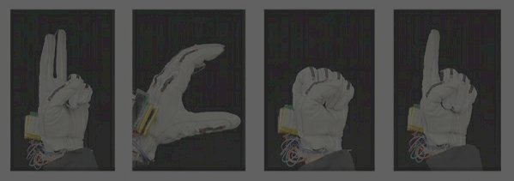
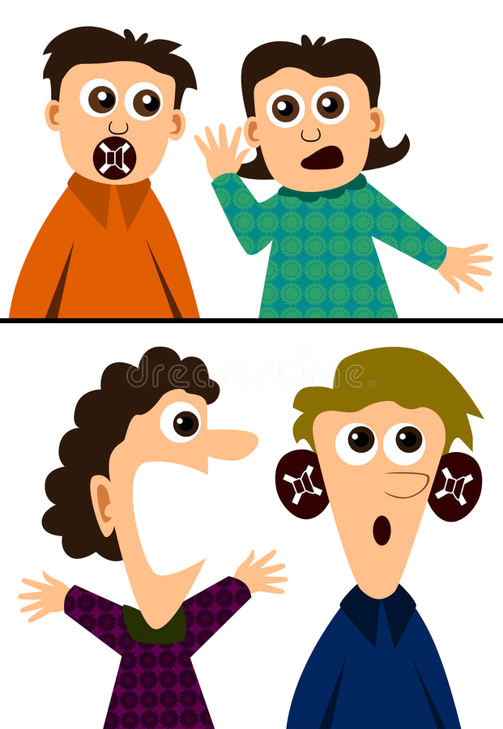
ABSTRACT
Over 30 million speech impaired people around the globe rely on sign language as means of communication but this isn’t understandable by most in common, thus this creates a barrier for the people with such impairment.
And thus the main objective of the implemented project is to develop a reliable, easy to use, light weight smart hand gloves system which can minimize the obstacles for such people where they can stand with the race.

Slide 3

INTRODUCTION AND BREIF WORKING
This project is an intelligent microcontroller based wireless system.
The main objective is to convert a hand gesture to speech and text.
Basically gestures are the input to the system.
Flex sensors are used to convert these gestures into a microcontroller input.
The glove is fitted with flex sensors along the length of each finger and the thumb. The flex sensors give output in the form of voltage variation that varies with degree of bend. This flex sensor output is given to the ADC channels of microcontroller. It processes the signals and perform analog to digital signal conversion. Further the processed data is sent in a wireless manner to the receiver section. In this section the gesture is recognized and the corresponding output is displayed on LCD and simultaneously a speech output is play backed through speaker.

Slide 4
LITERATURE REVIEW
Many smart gloves are proposed in recent years where preferred technology was wireless mode with many distinct features, but those were not reliable, light weight, cheap, Easy to use, plug and play type prototypes. It is because of components used for fabrication which are normally available in market such as flex sensors, microcontroller, and wireless transmitter, and these were powered by battery which was little heavy as compare to other components.
In an attempt to open up the lines of communication and to spark a conversation between people who are hearing-impaired or have speaking disabilities, a student and designer at Goldsmiths University in London has developed a futuristic smart-glove named “Sign Language Glove” that‘s capable of translating sign language from hand gestures into a visual on-screen text as well as audible dialogue.

Slide 5
BLOCK DIAGRAM

Slide 6

RESULT AND CONCLUSION
As a solution to problem definition, these Smart Gloves Prototype not only displays the gesture into text, but it also able to convert in voices.
The Future Scope of this project would be to develop an AI system to recognize each and every gesture pattern of universal sign language and be made reliable for the impaired.
This will help most of the speech impaired and thus the end to the barrier of communication. And hence this induces a confidence in them and helps them to be independent.

Slide 7
References
* https://github.com/BSP-Embed/Smart-Gloves/
* K. V. Fale, Akshay Phalke, Pratik Chaudhari, Pradeep Jadhav. “Smart Glove: Gesture Vocalizer for Deaf and Dumb People”. International Journal of Innovative Research in Computer and Communication Engineering, Vol. 4, Issue 4, April 2016

Slide 8


